Slide 1

Chapter 14
People on the Move
Notes:
For a better classroom presentation flow, the order of some topics in this lecture outline differs slightly from the order of topics in the text and, where this occurs, some figures and tables are out of numerical order.

Slide 2
Learning Objectives
14.1 Describe the major categories of migration.
14.2 Discuss examples of the new immigrants to the United States and Canada.
14.3 Recognize how cultural anthropologists contribute to migration policies and programs.

Slide 3
People on the Move
Migration:
  The movement of a person or people from one place to another
  Multiple causes, depending on context
  Multiple consequences, depending on context

Slide 4
Categories of Migration
14.1 Describe the major categories of migration.
Categories Based on Spatial Boundaries
Categories Based on Reason for Moving

Slide 5
Categories Based on
Spatial Boundaries (1 of 4)
Internal migration
  Movement within country boundaries
International migration
  Movement across country boundaries
Transnational migration
  Movement in which a person regularly moves back and forth between two or more countries and forms a new cultural identity transcending a single geopolitical unit

Slide 6
Categories Based on
Spatial Boundaries (2 of 4)
Internal Migration
  Rural-to-urban is the dominant form
  Push–pull theory of labor migration
    This theory developed in response to high levels of rural-to-urban migration in the mid-twentieth century
    Based on quality-of-life factors and “rational choice,” a person’s assessment of where a better life can be achieved

Slide 7
Categories Based on
Spatial Boundaries (3 of 4)
International Migration
  Growing rates since 1945
  Work-related reasons important for voluntary migrants
  Increasing numbers of involuntary international migrants, especially refugees and trafficked persons
  Racist and politicized policies in many of the major destination countries about which immigrants to admit

Slide 8
Categories Based on
Spatial Boundaries (4 of 4)
Transnational Migration
  Defined as migration in which a person regularly moves back and forth between two or more countries
  Much transnational migration motivated by economic factors
  Importance of remittances
    Example: Tonga
  Questions of “citizenship” and identity

Slide 9
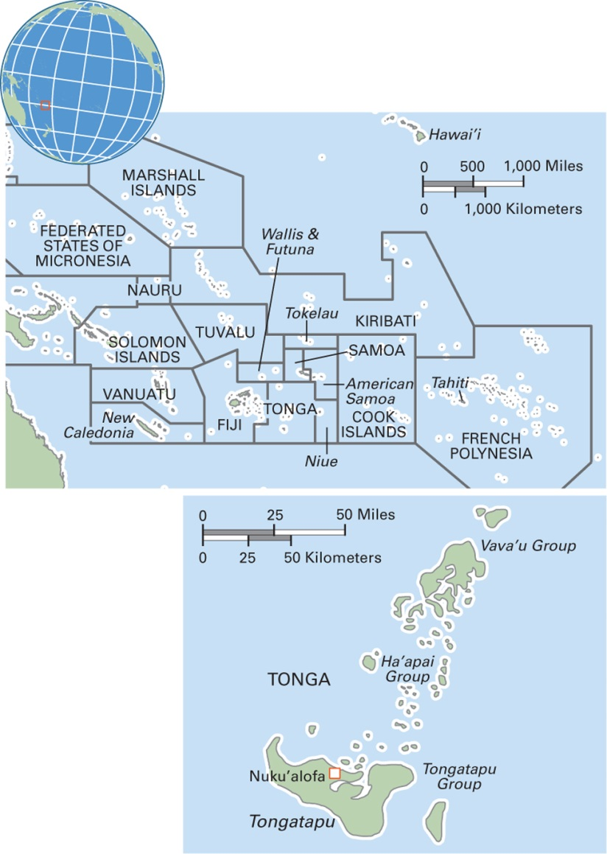
Map 14.1 Tonga
Notes:
The Kingdom of Tonga is an archipelago of 169 islands, nicknamed by Captain Cook as the Friendly Islands on the basis of his reception there. Tonga is a monarchy, and the current king is Tupou VI, who assumed the throne in 2012. Before him, Queen Salote Tupou II reigned from 1918 to 1965. The population is around 106,000, with two-thirds living on the main island, Tongatapu. Rural Tongans are small-scale farmers. Most Tongans are ethnically Polynesian, and Christianity is by far the dominant religion. Languages are Tongan and English. Many Tongans have emigrated, and remittances are a major part of the economy.

Slide 10
Categories Based on
Reason for Moving (1 of 6)
Labor Migrants
  Work period brief; no permanent residence
  When legally contracted, it is called wage labor migration
  Example: circular migration of women domestic workers in Latin America and the Caribbean

Slide 11
Categories Based on
Reason for Moving (2 of 6)
Displaced Persons
  Refugees
    Victims of persecution, natural disaster, other
  Internally displaced persons (IDPs)
    Remain in their home country; victims of persecution, natural disaster, other
  Development-induced displacement
    Victims of projects such as dams, mines, shopping centers, urban growth

Slide 12
Categories Based on
Reason for Moving (3 of 6)
Refugees
  A large and growing category of displaced persons
  Roughly 16 million people today are refugees—that is more than one of every 500 people in the world
  Women and children are the majority of refugees

Slide 13
Categories Based on
Reason for Moving (4 of 6)
Internally Displaced Persons (IDPs)
  The fastest-growing category of displaced people
  Perhaps 38 million IDPs today
  Africa is the continent with the most IDPs
  Political violence the major cause, as well as development projects (development-induced displacement, DID)

Slide 14
Categories Based on
Reason for Moving (5 of 6)
Development-Induced Displacement
  Dam projects alone have displaced 80 million people
  Example: Three Gorges Dam in China

Slide 15
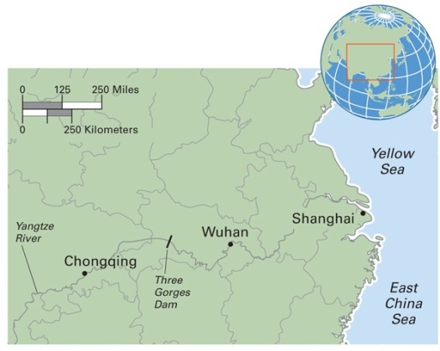
Map 14.2 Site of Three Gorges Dam in China
Notes:
The Three Gorges Dam, the world’s biggest dam, is one of several projects that are transforming China’s environment. The dam has created a vast reservoir upstream to Chongqing. Engineers believe that the dam will solve the problem of annual flooding of the Yangtze River, the world’s third-largest river, and generate immense amounts
of power. Environmentalists point to the downsides, which include the decline of many important fish species, destabilizing slopes, and eroding islands in the Yangtze River delta. Cultural anthropologists are concerned about the forced migration of over one million people from 13 major cities and 140 villages, and the loss of rural farming livelihoods as land is flooded. Archaeologists decry the loss of unknown numbers of prehistoric and historic sites now buried under water. Others mourn the loss of one of the most beautiful places in the world, with its “gumdrop” mountains and breathtaking vistas that have inspired artists for centuries.

Slide 16
Categories Based on
Reason for Moving (6 of 6)
Institutional Migrants
  People who move into a social institution, either voluntarily or involuntarily
    Members of the military
    Students
    The aged

Slide 17
Think Like an Anthropologist: Haitian Cane Cutters in the Dominican Republic: Structure or Agency? (1 of 2)
Men called braceros, agricultural workers allowed to enter a country for a specified period of time
Anthropologists and others have taken two positions on the Haitian braceros
  View 1: This system is a violation of Haitian men’s human rights
  View 2: Haitian braceros are exercising free choice when they go to the Dominican Republic to work

Slide 18
Think Like an Anthropologist: Haitian Cane Cutters in the Dominican Republic: Structure or Agency? (2 of 2)
Research by anthropologist Samuel Martínez reveals a more complex understanding of motivation and choice
He shows that the braceros are not really “free” to “choose” to work in the DR because of the extreme poverty in Haiti
It is not free choice, it is “structured choice” or “illusory choice”

Slide 19
Culturama: The Maya of Guatemala (1 of 2)
The term Maya refers to a diverse range of indigenous people who share elements of a common culture and speak varieties of the Mayan language
Most live in Mexico and Guatemala
Descendants of a formerly rich and powerful civilization, most Maya now live in poverty and lack basic human rights

Slide 20
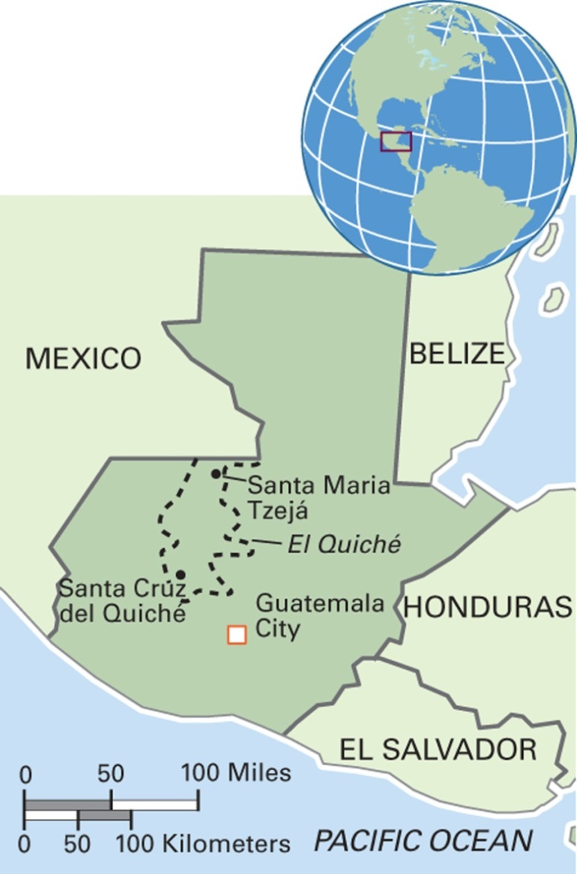
Map 14.3 Guatemala
Notes:
Within the Republic of Guatemala, the Maya constitute about 40 percent of the country’s population of 14 million.

Slide 21
Culturama: The Maya of Guatemala (2 of 2)
The Maya in Guatemala suffered years of genocide during the 36-year civil war
  200,000 were “disappeared”
  250,000 live as IDPs today
Case study of Maya people who left their home area and poverty for a better life in the lowland jungle
  Their new village of Santa María Tzejá was subjected to terrorism and brutally attacked
  Survivors fled into the jungle
  Some went to Mexico and the United States
  After the 1996 peace accords, some returned and began to rebuild

Slide 22
Think Like an Anthropologist: Stress among Boarding School Girls in Madagascar
According to ethnographic research, in a boarding school in Madagascar, girls experience more adjustment strains than boys
Teenage girls experienced spirit possession
Analysis of findings
  Spirit possession is associated with a girl being unmarried and pregnant
  An expression of the girl’s distress
  Her difficult position between country/city and girlhood/womanhood

Slide 23
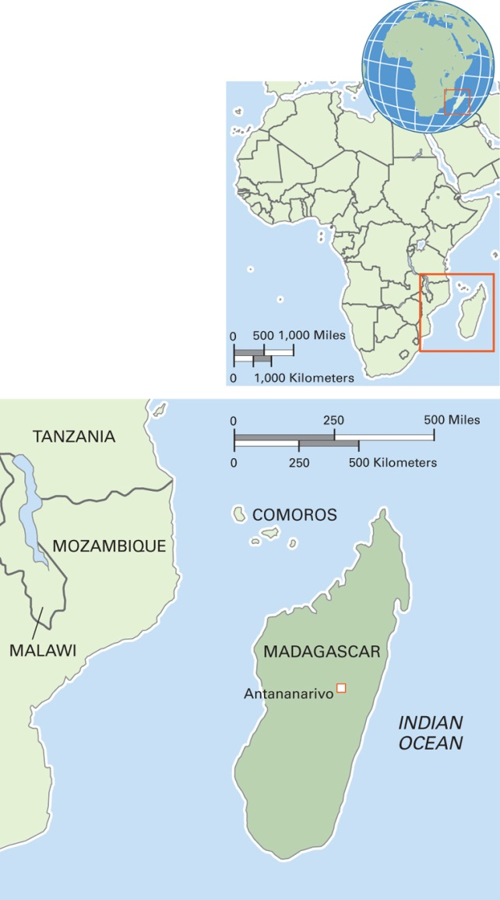
Map 14.4 Madagascar
Notes:
The Republic of Madagascar includes the main island of Madagascar and several much smaller islands off its coast. It is the home of five percent of the world’s plant and animal species, of which 80 percent are unique to Madagascar. The terrain varies from highlands to lowlands, rainforests, and deserts. The economy is reliant on tourism, especially ecotourism, and mining is increasing. The total population is 22 million. DNA analysis reveals that the population is a mixture of Malay and East African heritage. The primary language is Malagasy, which shares about 90 percent of its vocabulary with a language in southern Borneo. About half the people practice traditional religions related to ancestors, and most others are Catholics or Protestants.

Slide 24
The New Immigrants to the United States and Canada (1 of 2)
14.2 Discuss examples of the new immigrants to the United States and Canada.
The New Immigrants from Latin America and the Caribbean
The New Immigrants from Asia
The New Immigrants from the Former Soviet Union

Slide 25
The New Immigrants to the
United States and Canada (2 of 2)
Trends
  Globalization
    More countries are involved
  Acceleration
    Growth in the number of migrants worldwide
  Feminization
    Women are a growing percentage of all categories of international migration

Slide 26
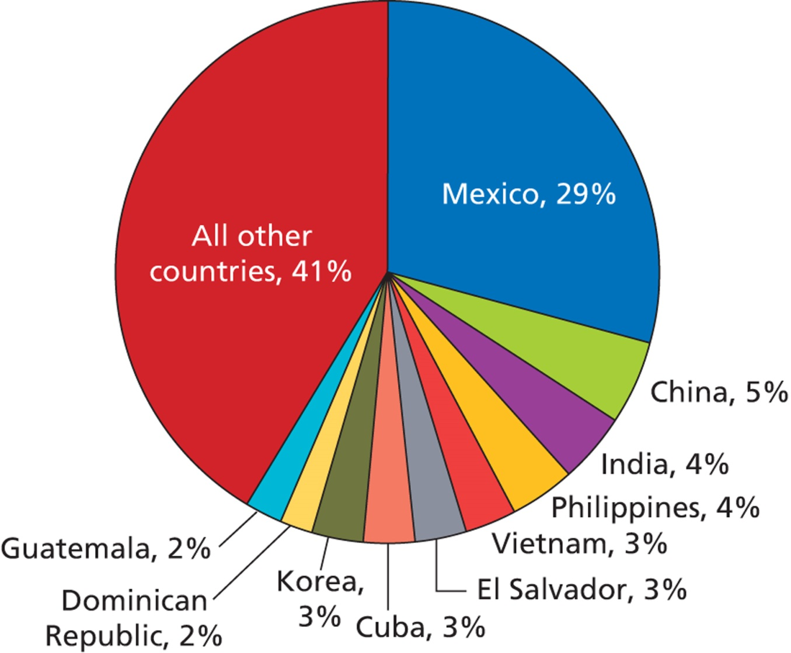
Figure 14.1 Immigrants to the United States as a Percentage of the Total, by National Origin, 2010

Slide 27
The New Immigrants from
Latin America and the Caribbean
Mexican immigrants
  Major source of foreign-born residents in the U.S.
  Many seasonal immigrants
Dominicans
  One of the fastest-growing immigrant groups in the U.S.
  Chain migration
Salvadorans
  Major stimulus for moving was the decade-long civil war
  The “working poor” on Long Island

Slide 28
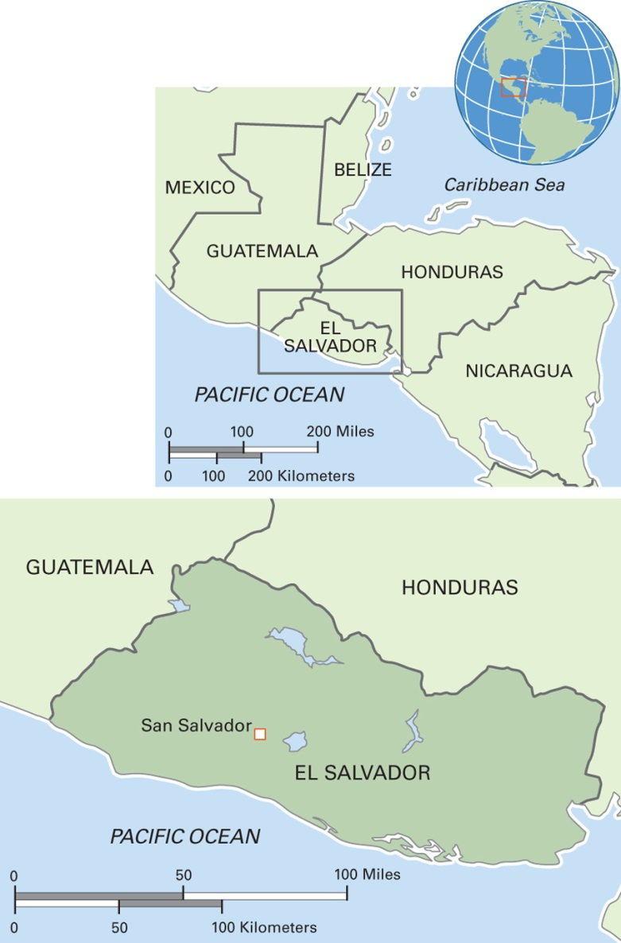
Map 14.5 El Salvador
Notes:
In recent times, the Republic of El Salvador has tended to emphasize one or two major export crops, with coffee being dominant. Coffee growing requires high-altitude land, and therefore coffee production has displaced many indigenous people. The country’s total population is nearly six million. About 90 percent are mestizo, nine percent of European descent (mostly Spanish), and one percent indigenous. The dominant language is Spanish, although some indigenous people speak Nahuat. Eighty-three percent of the people are Roman Catholic, and Protestants are 15 percent and growing in number.

Slide 29
The New Immigrants from Asia (1 of 3)
Changing Patterns of Consumption among Hong Kong Chinese
  Urban clustering
  Expanded consumption of Anglo-Canadian products
  Tend to be economically well-off

Slide 30
The New Immigrants from Asia (2 of 3)
Three Patterns of Adaptation among Vietnamese-Americans
  Three distinct subgroups and patterns of adaptation
    1975-era elite
    Boat people
    Ethnic Chinese

Slide 31
The New Immigrants from Asia (3 of 3)
Hindus of New York City Maintain Their Culture
  First wave of Hindu immigrants well-educated
  Later waves less so
  Hindu temple in New York City adapts to the diverse religious practices of immigrants and works to appeal to youth

Slide 32
The New Immigrants from the
Former Soviet Union
Many people were displaced within the Soviet Union
When the Soviet Union collapsed, some attempted to return to their homeland (frequently in new states)
Since 1988, refugees from the former Soviet Union have been one of the largest refugee nationalities to enter the United States

Slide 33
Migration Policies and Programs in a Globalizing World
14.3 Recognize how cultural anthropologists contribute to migration policies and programs.
Protecting Migrants’ Health
Inclusion and Exclusion
Migration and Human Rights

Slide 34
Protecting Migrants’ Health
Health risks to migrants are many and varied
Of particular concern to anthropologists is groups whose livelihood depends on spatial mobility (foragers, horticulturalists, pastoralists)

Slide 35
Anthropology Works: Mapping African Pastoralists’ Movements for Risk Assessment and Service Delivery
Pastoralists are often vulnerable to malnutrition as a consequence of climate changes, fluctuations in food supply, and war/political upheaval
Cultural anthropologists collect information to assess relative risks of different events, so governments and international aid agencies can provide services before situations become severe

Slide 36
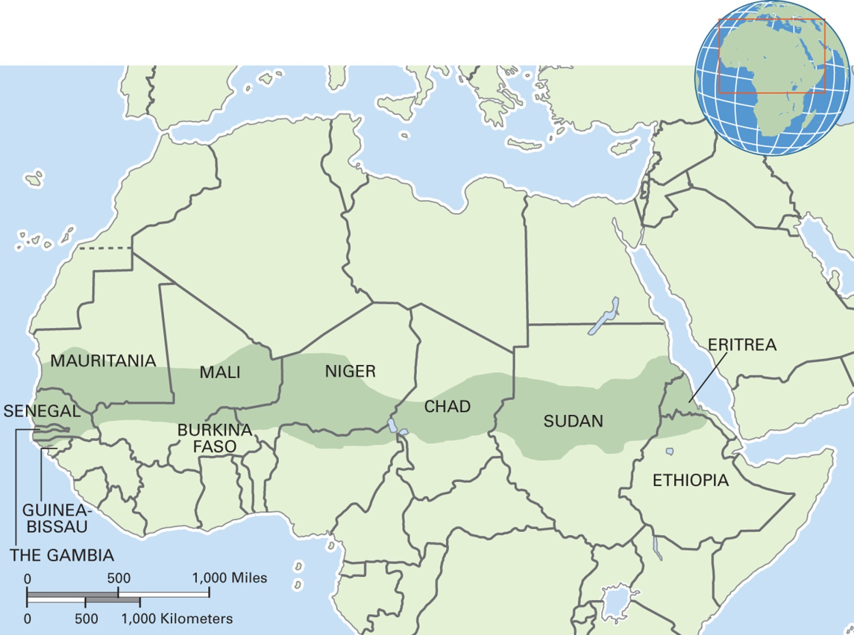
Map 14.6 Sahel Region
Notes:
The word sahel comes from the Arabic for “shore” or “border,” referring in this case to the area between the Sahara desert and the more fertile regions to the south. Primarily savanna, the region has been the home to many rich kingdoms that controlled Saharan trade routes. Most people make their living from pastoralism and semisedentary cattle raising. The region has recently experienced several major droughts, leading to the widespread death of herd animals, widespread human starvation and malnutrition, and forced population displacement. (Note: Since the time of this map, Sudan has split into two separate countries)

Slide 37
Inclusion and Exclusion
States may employ a cost-benefit analysis when considering immigration policy
  Cheap labor needed?
Lifeboat mentality
  A view that seeks to limit growth of a particular group because of perceived resource constraints

Slide 38
Migration and Human Rights
Issues related to forced migration
  The right of return
  Differential resettlement of IDPs
  Others—quality of life in camps

